Slide 1
Forest Cover Type Data Analysis using AWSing AWS
Team Members:
Nishanth Dangethi – 801308165
Sushanth Reddy Boggula – 801305544
Vaishnavi Baiken – 801316841
Yashaswini Golla - ​​801312123
Amar Chowdary Gundapaneni - 801304875

Slide 2
Dataset Description Forest Cover Type Dataset
This dataset contains tree observations from four areas of the Roosevelt National Forest in Colorado. All observations are cartographic variables (no remote sensing) from forest. There are over half a million measurements total!
This dataset includes information on tree type, shadow coverage, distance to nearby landmarks, soil type, and local topography Etc.

Slide 3
Business Problem and Domain Knowledge
Forest Management:
One business opportunity that can be derived from the Forest Cover Type Dataset is in the field of forest management. By analyzing the various attributes of the dataset such as elevation, slope, soil type, and vegetation, forest managers can make informed decisions on forest planning, regeneration, and monitoring. This can result in more efficient and sustainable management of forest resources.
The Forest Cover Type Dataset requires domain knowledge in forestry and environmental science. Understanding the different tree species, soil types, topography, and climatic conditions that influence forest cover is important to fully interpret the data.

Slide 4
Research Objectives and Questions
Amazon S3 is used to create buckets and store the data. Glue is used for data crawling, and Athena is used for querying the data. Sagemaker is used to create Jupyter Notebook for data preparation and cleaning. Designing detailed and engaging dashboards for visualizing our derived conclusions after analysis are made using Amazon QuickSight.
1. Do seasonal changes hill shade at noon stay relatively the same over years?
2. Is the relationship between soil type and horizontal distance to hydrology affected by horizontal distance to roadways?
3. Are specific tree types more likely to grow/are more affected by environmental factors such as soil type and distance to fire points?
4. Does the relationship between shade at different times of the day affect the soil type?

Slide 5
Services Used

Slide 6
S3
Amazon S3 (Simple Storage Service) is a cloud-based storage service offered by Amazon Web Services (AWS). It provides developers and businesses with scalable and secure object storage for various types of data. S3 supports storing and retrieving any amount of data from anywhere on the web. It provides features such as data encryption, versioning, and lifecycle management to manage data effectively. S3 is widely used in various industries, including media, finance, healthcare, and government, for backup and disaster recovery, big data analytics, and content delivery.

Slide 7
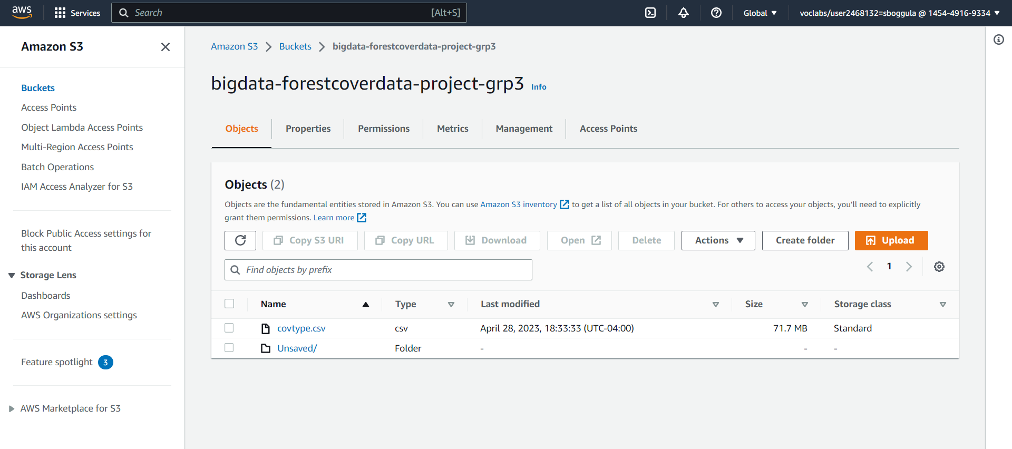

Slide 8
Glue
AWS Glue is a fully-managed extract, transform, and load (ETL) service that enables customers to prepare and load data for analytics. It offers a simple and cost-effective way to categorize, cleanse, enrich, and move data between various data stores. AWS Glue supports popular data sources including Amazon S3, Amazon RDS, and Amazon Redshift, as well as databases in on-premises data centers. The service also provides an easy-to-use interface to create, monitor, and manage ETL jobs. AWS Glue offers a serverless architecture, so customers do not need to worry about managing infrastructure and can instead focus on their data pipelines.

Slide 9
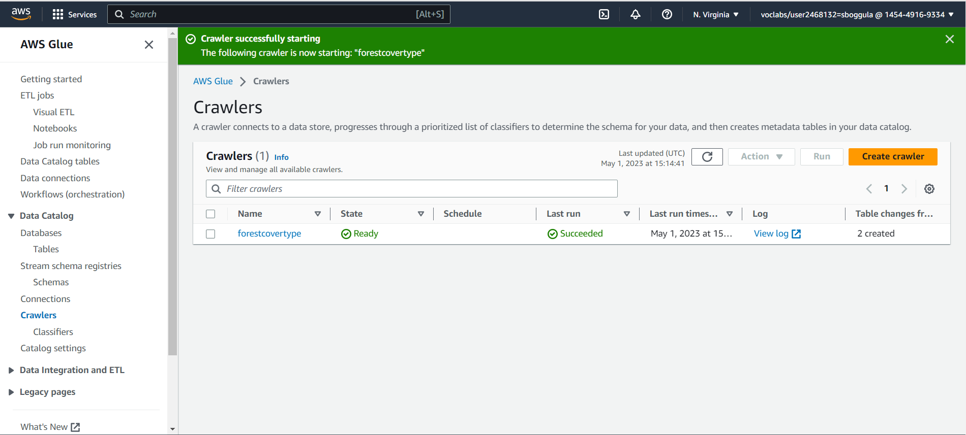

Slide 10
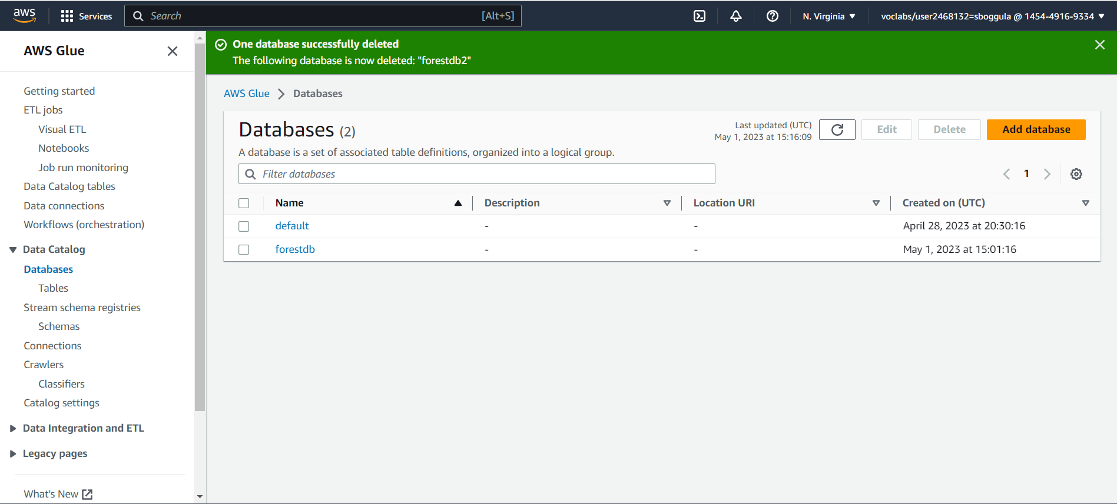

Slide 11
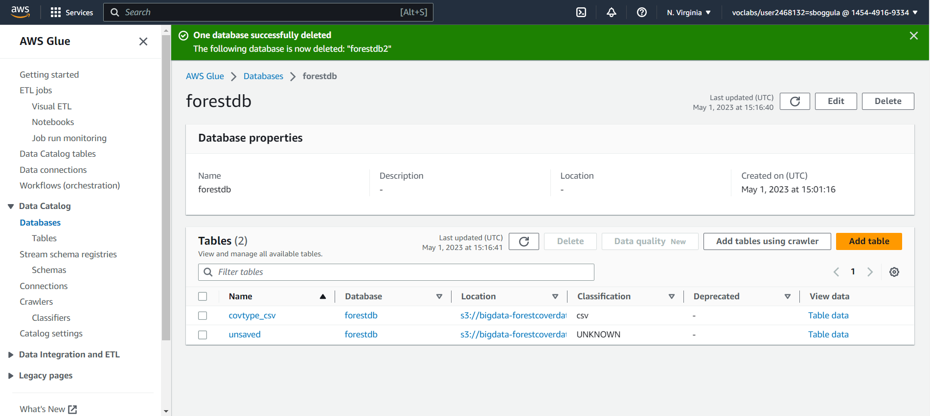

Slide 12
Athena
AWS Athena is a serverless interactive query service that allows querying data in Amazon S3 using standard SQL. It offers easy integration with AWS Glue and supports a wide range of data formats. Athena is highly scalable and can handle large datasets with ease. It offers pay-per-query pricing, which means users only pay for the amount of data scanned by their queries. Additionally, Athena has built-in security features that ensure the protection of data at rest and in transit.

Slide 13
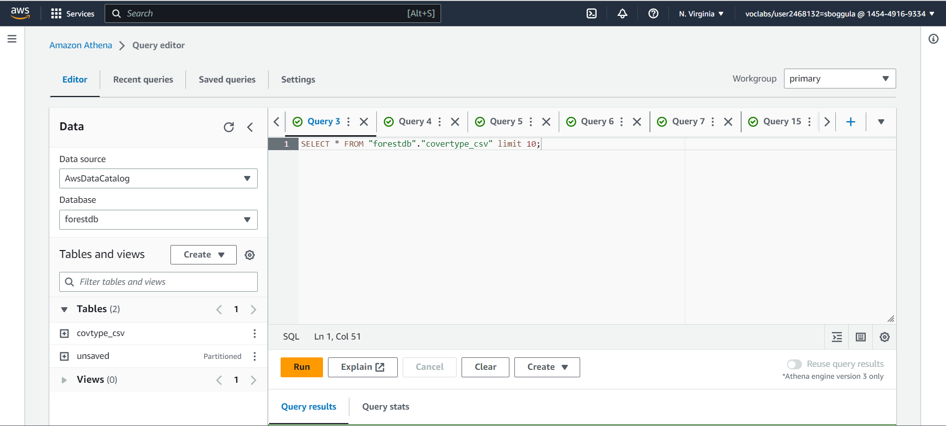

Slide 14
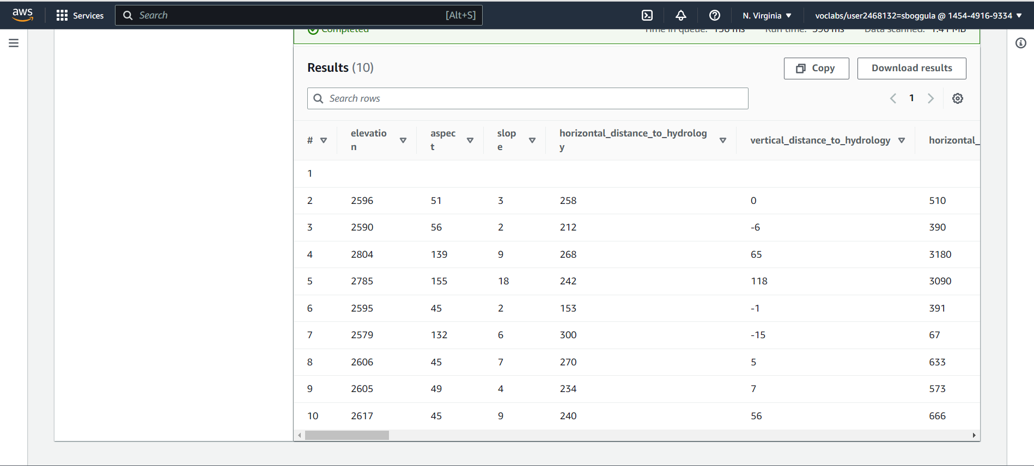

Slide 15
Sagemaker
AWS SageMaker is a fully-managed service that enables developers and data scientists to build, train, and deploy machine learning models at scale. It provides a range of built-in algorithms, frameworks, and development environments to support the entire machine learning workflow. SageMaker offers features such as automatic model tuning, data labeling, and hosting, allowing for seamless experimentation and deployment. The service also supports deployment of models to production using a variety of methods, including API endpoints and batch inference.

Slide 16
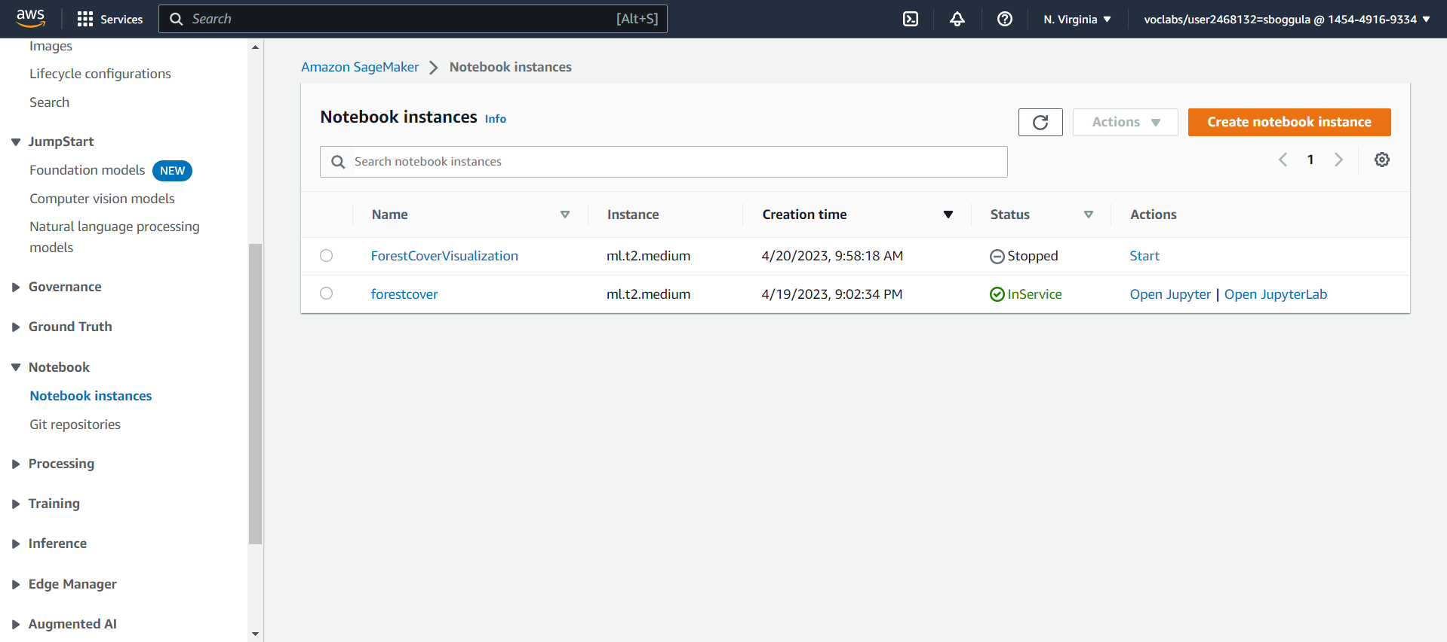

Slide 17
Quicksight
AWS QuickSight is a cloud-based business intelligence tool that enables users to create and visualize interactive data dashboards, charts, and reports. It offers easy data integration with various data sources, including AWS services and third-party applications. QuickSight provides pre-built templates and visualizations to help users get started quickly. It has advanced machine learning capabilities, such as anomaly detection and forecasting, to discover insights in large data sets. QuickSight also provides security features, including data encryption and access control, to ensure data protection.

Slide 18
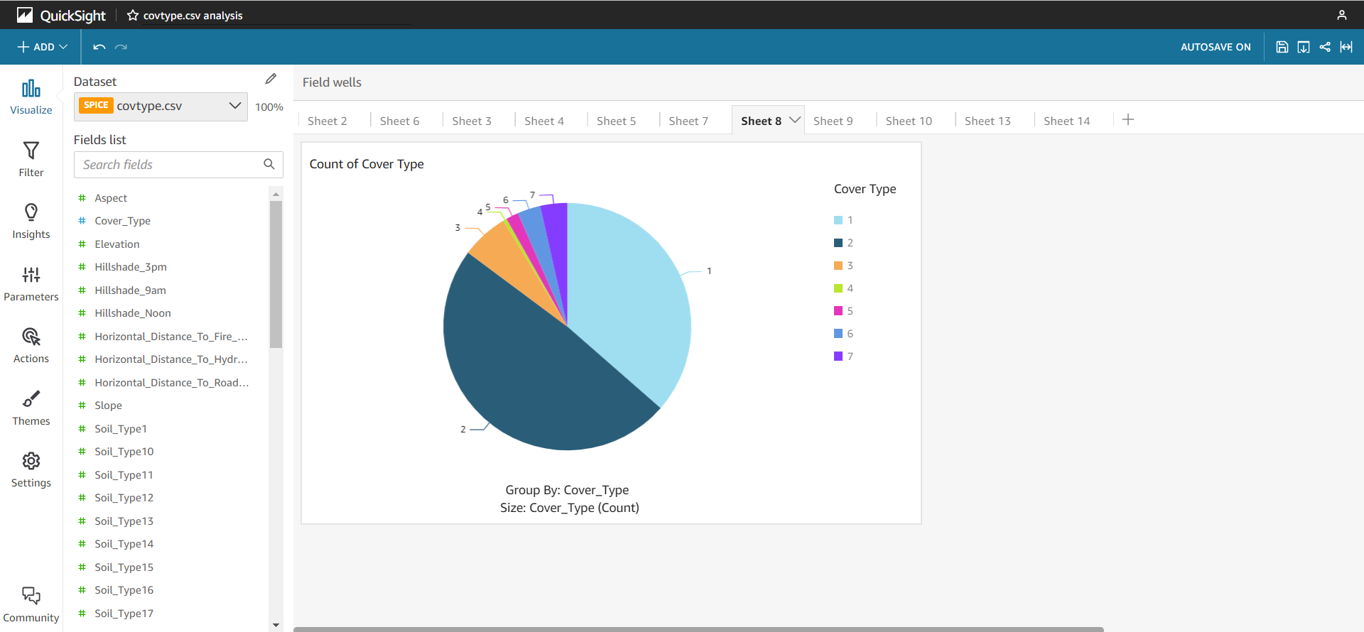

Slide 19
Future Work and Comments
The dataset has a lot of potential for more future work such as we can predict what types of trees grow in an area based on the surrounding characteristics?. You can also explore different algorithms such as gradient boosting, neural networks, and deep learning models, and evaluate their performance on the dataset.
The evaluation process typically involves dividing the data into training and testing sets, training the model on the training set, and evaluating the model’s performance on the testing set using metrics such as accuracy, precision, recall, F1 score, and AUC-ROC. We also checked how different features are important in predicting the target variable. For this project, we created three classification models using Logistic Regression, Decision Tree and Random forest classifier supervised learning techniques. Out of the three model Random forest classifier gave the highest accuracy of 95.6%.

Slide 20
Thank You

